Slide 1


Slide 2

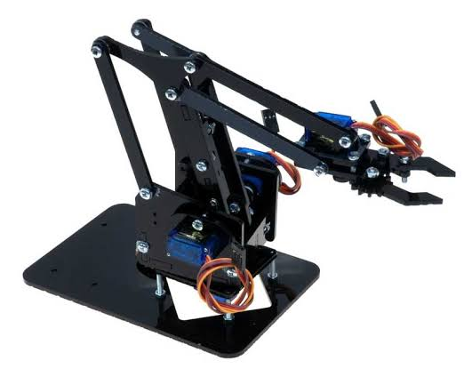
AUTOMATIC PICK AND DROP ROBOTIC ARM

Slide 3
21-ME-11
21-ME-83
21-ME-15
21-ME-103
Group
Members
21-ME-19
Group
Members
21-ME-107
21-ME-31
21-ME-115
21-ME-43
21-ME-131
21-ME-47
21-ME-163
21-ME-55
21-ME-175
21-ME-179

Slide 4
Introduction
Kinematics Analysis
Objective
Grashoff’s Condition
Aims and Benefits
Results and Analysis
Components Overview
Suggestions
Designing Steps
Solid Work Model
Summary of Data Collection

Slide 5
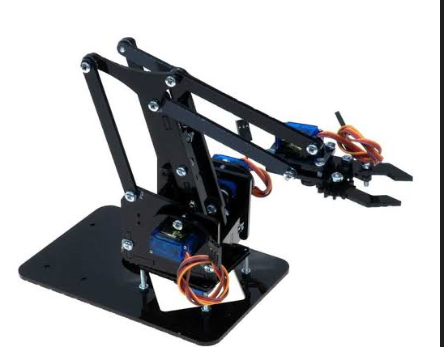
Introduction:
The Pick and Place Automatic Robot (PPAR) is a smart robot designed to handle objects in industries like manufacturing and logistics. It helps by picking up items from one place and putting them in another with great precision.

Slide 6
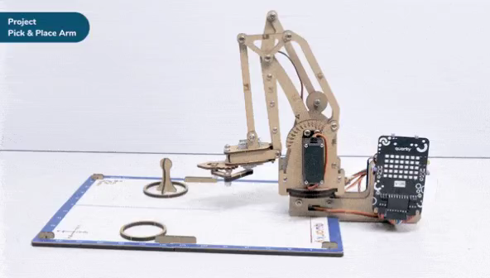
Objective:
The Pick and Place Automatic Robot (PPAR) automates object handling in industries like manufacturing, logistics, and assembly.
It incorporates technologies such as computer vision, machine learning, and robotic arm manipulation.
Key components include sensors, robotic arm, grippers, and control system.
Benefits include increased productivity, improved precision, and reduced human labor requirements.
Represents a significant advancement in automation technology with potential to revolutionize various industrial applications.

Slide 7
Aims:
Benefits:
Automate tasks.
Boost productivity.
Enhance precision.
Reduce labor.
Revolutionize industries
Using the PPAR has a bunch of advantages:
Saves time and effort because it does the work automatically.
Makes fewer mistakes than humans, so it's super precise.
Reduces the need for people to do repetitive tasks.

Slide 8
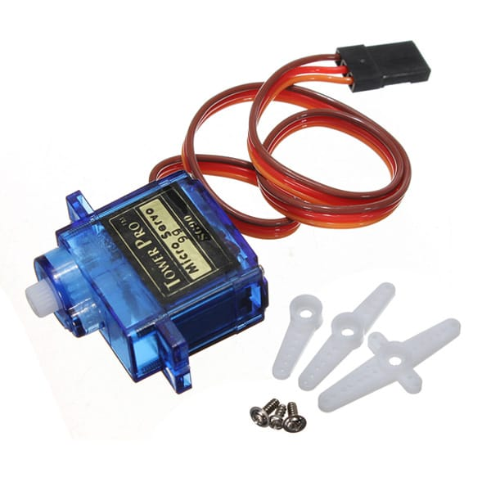
Components Overview
Servo Motors:
These are small motors weighing only 10g and measuring about 22.2x11.8x31 mm. They have a torque of 180 N mm and operate at 4.8V with a rotation speed of 120 rpm. Three of these are used in the PPAR for their compactness and lightweight nature, perfect for small-scale robotics.

Slide 9
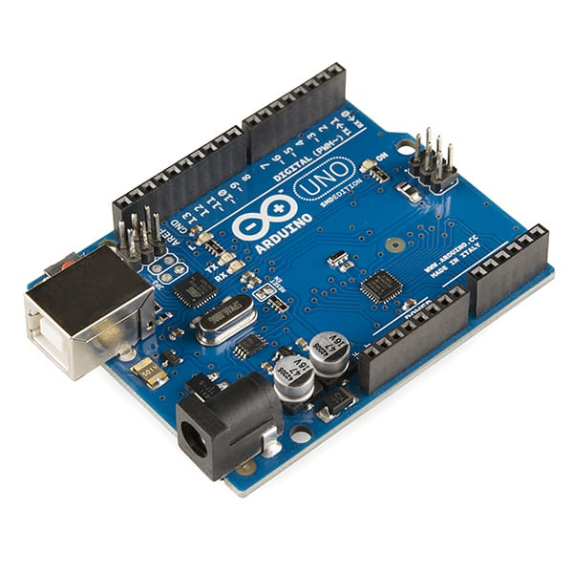
Components Overview
Arduino Board (UNO):
This is like the brain of the PPAR. It's a small but powerful microcontroller board with features like 6 PWM digital I/O pins, 6 analog input pins, and 32 KB of flash memory. It's about 68.6mm x 53.4mm in size and weighs 30g. Operating at 12V, it's versatile and ideal for controlling the robot's component.

Slide 10
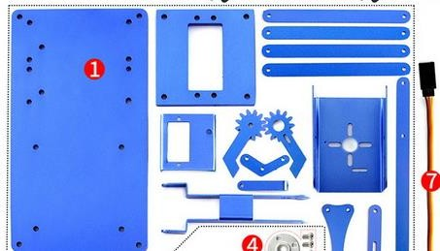
Components Overview
Acrylic Plates:
These are used to build the arms and links of the robot. They're made of lightweight yet durable acrylic material, 3mm thick. Acrylic is known for its transparency and impact resistance. With a tensile strength of 69 N/mm^2, these plates are strong enough to handle the job while keeping the weight manageable.

Slide 11
Steps to Designing a Robotic Arm
Conceptual Design
SolidWorks Assembly
Sketch different concepts for the robotic arm based on the defined requirements.
Explore various configurations, joint types, and linkages.
Consider ergonomics, efficiency, and ease of maintenance.
Start a new assembly file in SolidWorks.
Import or create individual parts like arms, joints, and motors.
Fit the parts together based on the conceptual designs.

Slide 12
Steps to Designing a Robotic Arm
Joints and Constraints:
Test and Validate:
Define the joints and motion constraints between the different parts of the robotic arm.
Use SolidWorks mates to simulate joints such as revolute, prismatic, and spherical.
Ensure that the joints allow the desired range of motion for each link.
Conduct motion studies and simulations to evaluate arm functionality.
Verify the arm's ability to reach desired positions and carry loads.
Iterate on the design based on simulation results and feedback

Slide 13
Steps to Designing a Robotic Arm
Finalization and Approval:
Make any necessary adjustments or refinements to the design based on validation outcomes.
Obtain approval from relevant stakeholders for the finalized design.
Prepare comprehensive manufacturing documentation, including part drawings and assembly specifications

Slide 14
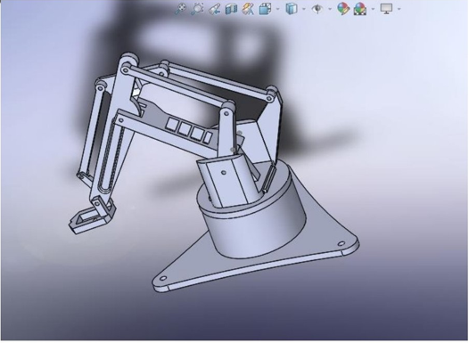
SolidWorks Model
Detailed 3D model created in SolidWorks for accurate representation.

Slide 15
Summary of Data Collection:
The acrylic plates collectively weigh 100g, with each individual plate having a weight of 25g.
The screws account for a total mass of 382g, spread across 1000 pieces, resulting in an average weight of 0.3829g per screw.
Each servo motor has a weight of 10g.
Regarding motor M2, its calculations reveal a maximum stretchable length of 110mm and a torque of 180 N mm, allowing it to lift a maximum weight of 38.8g.

Slide 16
Kinematics Analysis:
We analyzed a linkage configuration using the open-source software Linkage. This setup comprises four distinct links, each characterized by its length and function :
Ground Link (L1): 153mm
Rocker Link (L2): 86.2mm
Coupler Link (L3): 127mm
Slider Link (L4): 40mm
Analysis:
We focused on a crank-slider mechanism.

Slide 17
Grashoff’s Condition:
This condition helps predict the rotation behavior of a 4-bar linkage's inversions solely based on link lengths. In our case:
S = length of the shortest link = 40mm
L = length of the longest link = 153mm
P = length of one remaining link = 86.2mm
Q = length of another remaining link = 127mm
According to the Grashoff’s condition:
S + L should be less than or equal to P + Q.
With our values:
40 + 153 ≤ 86.2 + 127
193 ≤ 213.2
Since 193 is indeed less than 213.2, the Grashoff’s condition is satisfied.

Slide 18
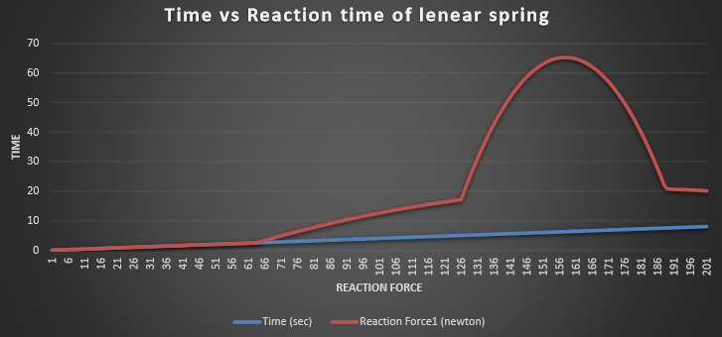
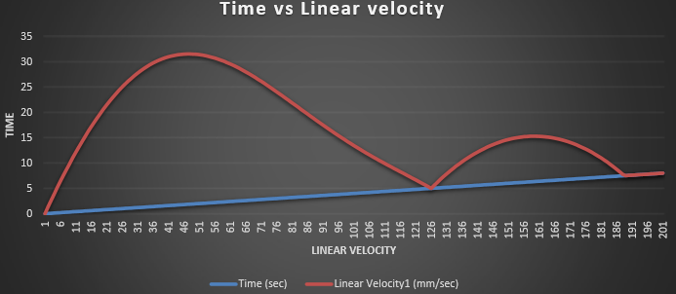
Results & Analysis

Slide 19
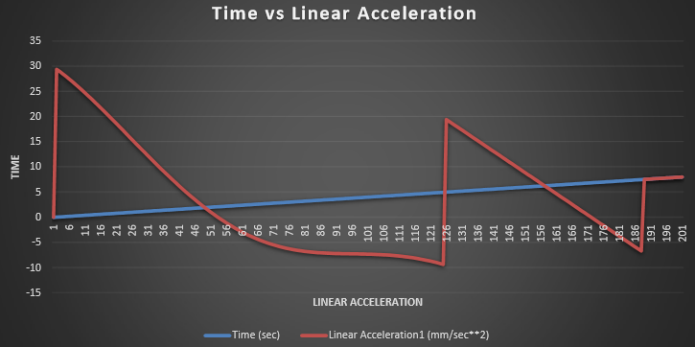

Slide 20
Suggestions:
Increase in DOF
Load Capacity
High Strength
Control

Slide 21

Thank You

